Slide 1
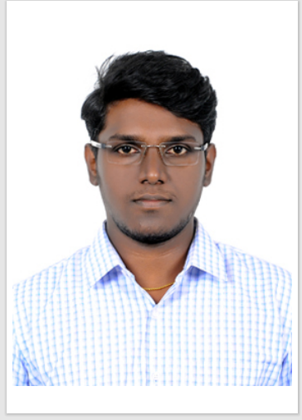
Ashwin| C1 – Senior Consultant
Ashwin
Senior Consultant
Professional Experience Highlights
Fluke Tech Support –Generative AI/ Azure :
Led the creation of a customer-centric chatbot to optimize technical support interactions.
Efficiently extracted valuable data from various online sources using Selenium.
Enhanced and executed workflows on Logic Apps, contributing to streamlined business processes.
Ensured smooth and error-free application and system deployments, showcasing deployment expertise.
Fluke Document Translator –Azure Open AI / Azure :
Worked in the development of a Python web application that harnessed the capabilities of Azure-Open AI to translate user-uploaded documents into the desired language.
The application was constructed using Python, including Flask and Streamlit, and was hosted on Azure Web App.
It offered a user-friendly and seamless interaction experience for customers through the use of Python's Streamlit library.
Fluke VOC –Summarization – Azure Open AI – GPT 4 / Databricks:
Utilized the capabilities of the GPT-4 model to extract transcripts from customer knowledge videos.
Employed Databricks to collect raw data files and injected into Azure storage account to store and process the transcripts.
Carried out smooth conversions, data generation, and extensive test cases.
Demand Supply Solutions – Generative AI / GCP:
Designed a proof of concept (POC) for a cutting-edge job description matching system, incorporating Google's Gen AI text summarization methods.
Constructed resilient Python APIs using Flask and React.js to facilitate seamless platform interaction.
Leveraged Google's text-bison@001 for extracting crucial details from resumes.
Integrated a Neo4j graph database with the use of Cypher queries to enhance efficient data interaction.
Personal Statement
Enthusiastic data Scientist having prior Experienced in working on Generative AI, Python development & Machine Learning project. Google cloud Professional Machine Learning Engineer Certified. Proficient in advanced analytics, machine learning, and statistical techniques for deriving actionable insights. Bringing a solid history of creating and deploying secure AI solutions across various domains on cloud platforms.
Expertise and Competencies
GCP Services – Gemini, Vertex AI
Azure Services – GPT 3.5, Cognitive search, Logic Apps
Databricks, Data Lakes
Python Development- Flask, Streamlit, Rest API
Generative AI, LLM, Machine Learning , Deep Learning
DB- (BigQuery, MySQL, Neo4j, Cosmos DB )
Data Visualisation ( Power BI, Looker Studio)
Project management , Team Handling
Professional Qualifications and Certifications
Post Graduated in Data Science and Engineering
Certified Google Professional Machine Learning Engineer
Generative AI fundamentals

